Slide 1

FACIAL EXPRESSION DETECTION SYSTEM Project Synopsis Presentation Date: DD/MM/YYYY
Course Name (Course Code)
Degree : BCA(CTIS)3rd year
Project Guide:
Mr. Arshad Ali
Aashna ali (TCA20560001)
Ritik Gupta (TCA2056019)
Tushar Agarwal (TCA2056024)
Sandeep sharma(TCA2056021)
FACULTY OF ENGINEERING & COMPUTING SCIENCES
TEERTHANKER MAHAVEER UNIVERSITY, MORADABAD

Slide 2

Team Details
Student Name | Role
AASHNA ALI | Developer, Testing etc.
RITIK GUPTA | Researcher.
TUSHAR AGARWAL | Developer, Testing etc.
SANDEEP SHARMA | Researcher.
Guidelines: Mention Team Names & their role in project
2
T011A/ Template Version 5.0

Slide 3

Facial expression recognition system
Facial Emotion Recognition is a technology used for analysing sentiments by different sources, such as pictures and videos. It belongs to the family of technologies often referred to as ‘affective computing’, a multidisciplinary field of research on computer’s capabilities to recognise and interpret human emotions and affective states and it often builds on Artificial Intelligence technologies.
3
T011A/ Template Version 5.0

Slide 4
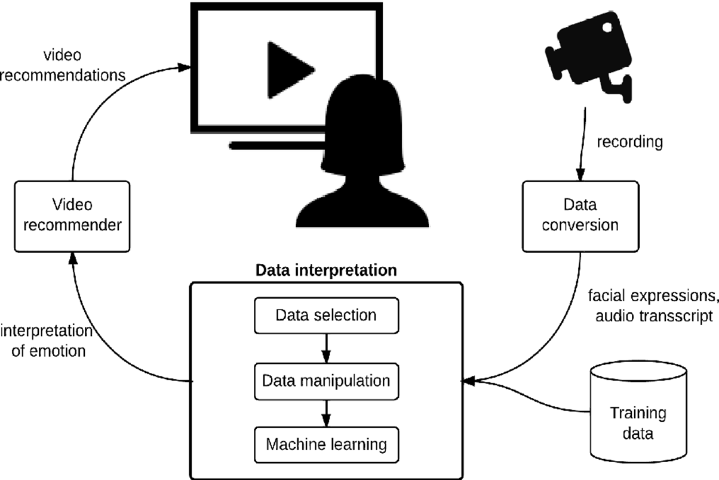
METHODOLOGY
A computer analyzes image data and looks for a very specific set of markers within it – everything from a person’s head shape to the depth of their eye sockets.
A database of facial markers is created, and an image of a face that shares a critical threshold of similarity from database indicates a possible match. This is the basic principle behind all types of facial recognition, from unlocking your iPhone by scanning your face, to intercepting known shoplifters as they enter a store.
4
T011A/ Template Version 5.0

Slide 5
TECHNOLOGIES USED IN THE PROJECT
Python IDE enviorment
Jupyter notebook/vsc code/python idle 3.11(any of the one )
REQUIRED LIBERARIES
CV2
OS
NUMPY
MATLIB
IMAGE
MODULES USED
FACE DETECTION MODULE
OBJECTS COUNTER MODULE
DIRECTION DETECTOR MODULE
5
T011A/ Template Version 5.0

Slide 6
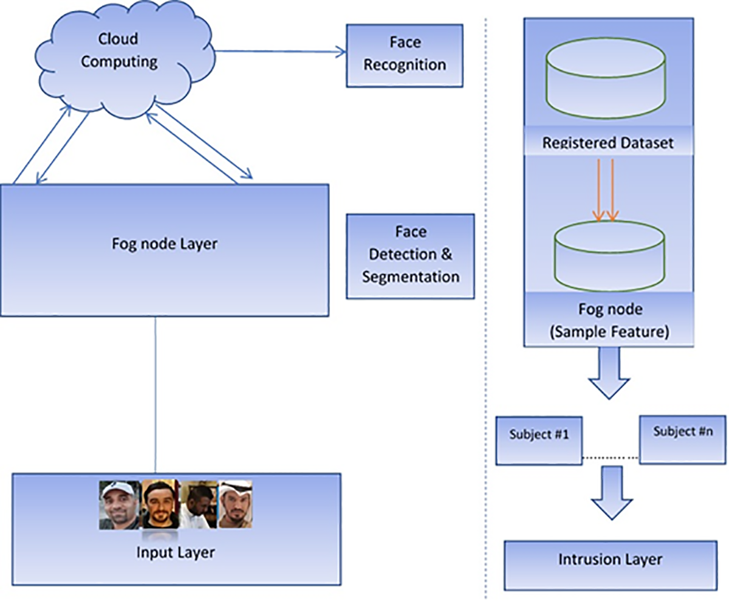
USE CASE DIAGRAM
6
T011A/ Template Version 5.0

Slide 7
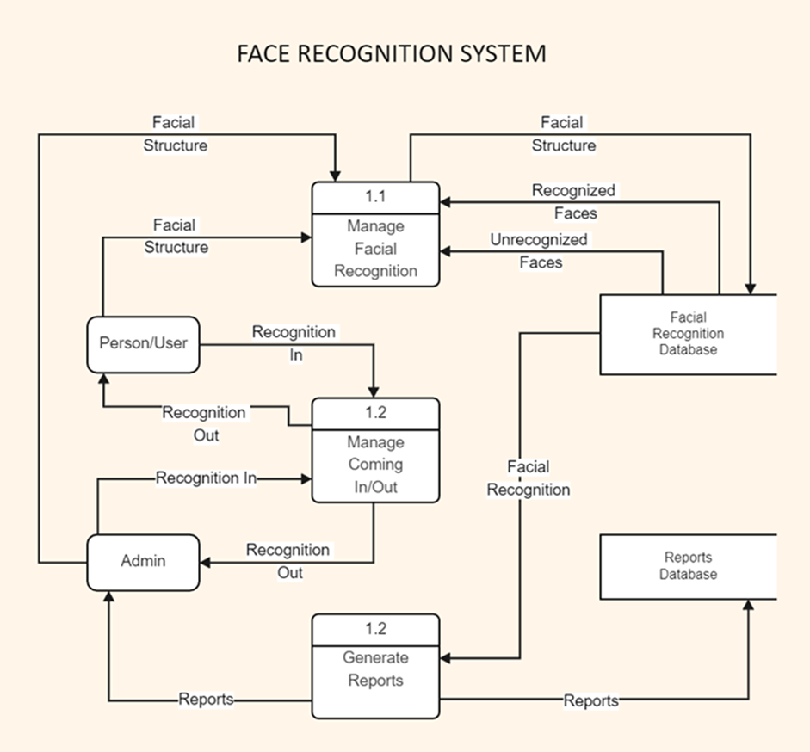
ERD DIAGRAM
7
T011A/ Template Version 5.0

Slide 8
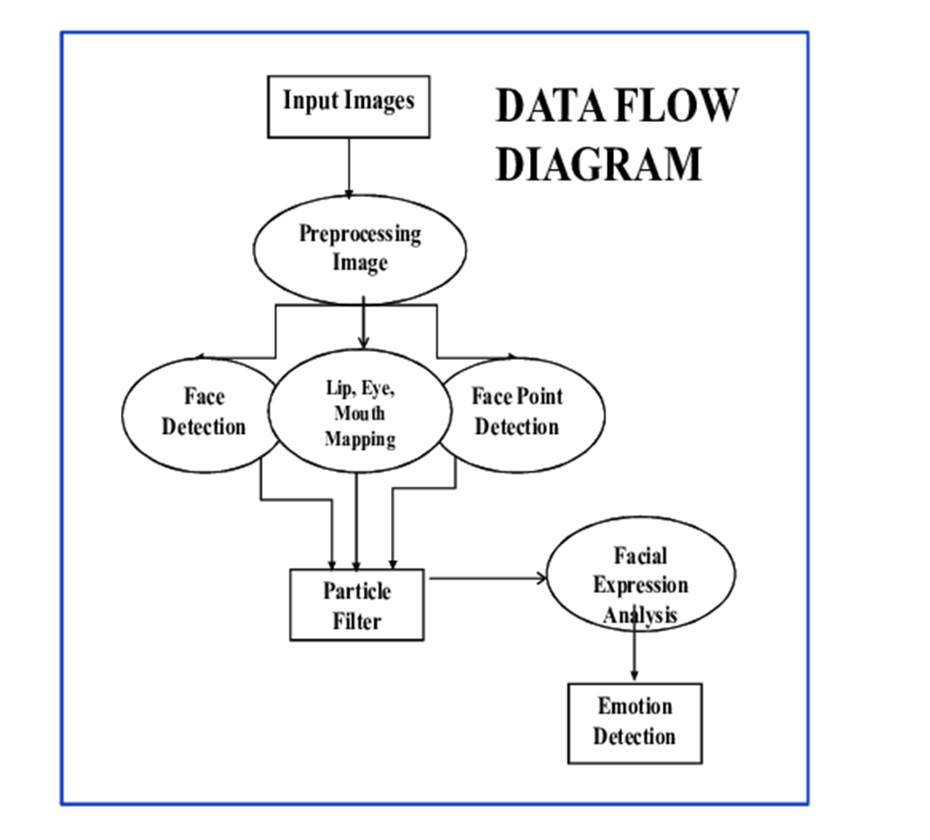
DATA FLOW DIAGRAM
Guidelines: Add more slides, if required to show all DFDs
8
T011A/ Template Version 5.0

Slide 9
\
ADVANTAGE OF THE PROJECT
Efficient security
Facial recognition is a quick and efficient verification system. It is faster and more convenient compared to other biometric technologies like fingerprints or retina scans. There are also fewer touchpoints in facial recognition compared to entering passwords or PINs. It supports multifactor authentication for additional security verification.
Improved accuracy
Facial recognition is a more accurate way to identify individuals than simply using a mobile number, email address, mailing address, or IP address. For example, most exchange services, from stocks to cryptos, now rely on facial recognition to protect customers and their assets.
Guidelines: Mention advantage from this project, the audience/ users who will get benefitted
9
T011A/ Template Version 5.0

Slide 10
REFERENCES
www.tutorialspoint.com/facial/system
www.researchgate.com/FERS
10
T011A/ Template Version 5.0

Slide 11
THANKS

